Slide 1
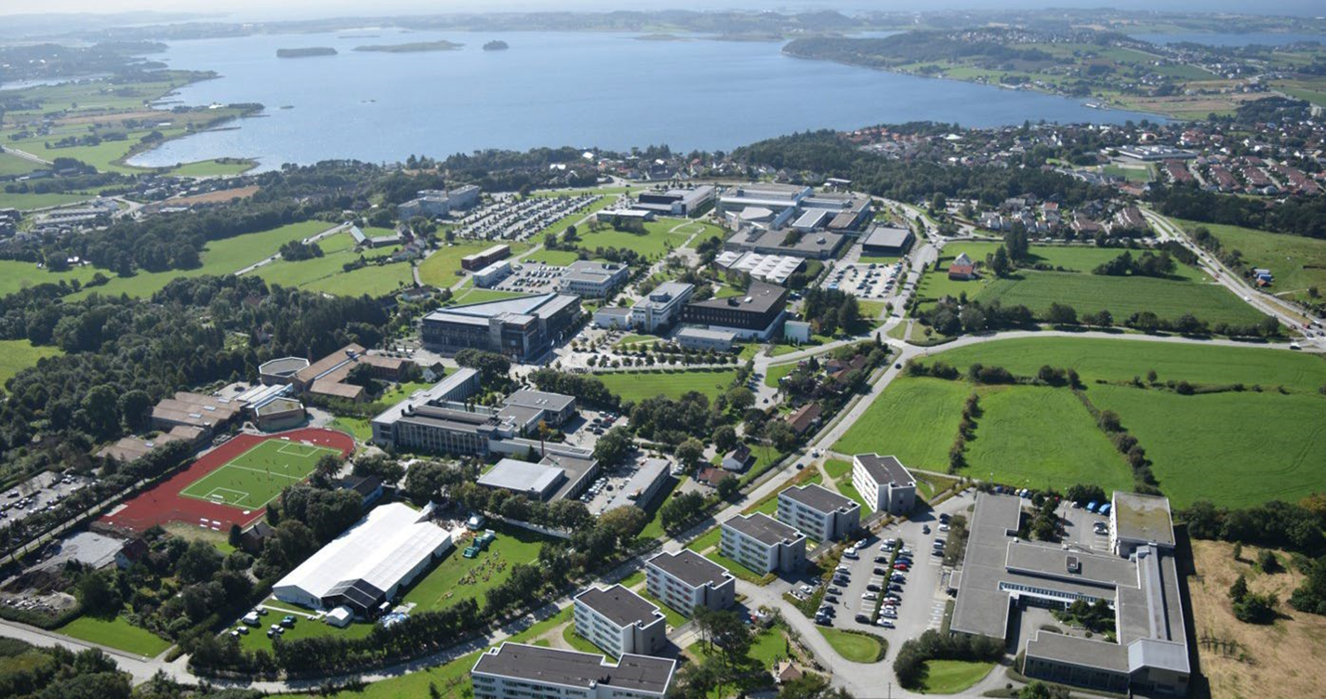


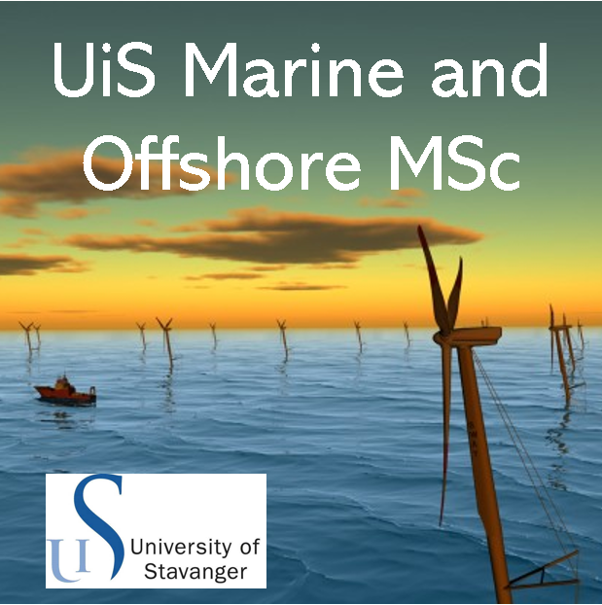
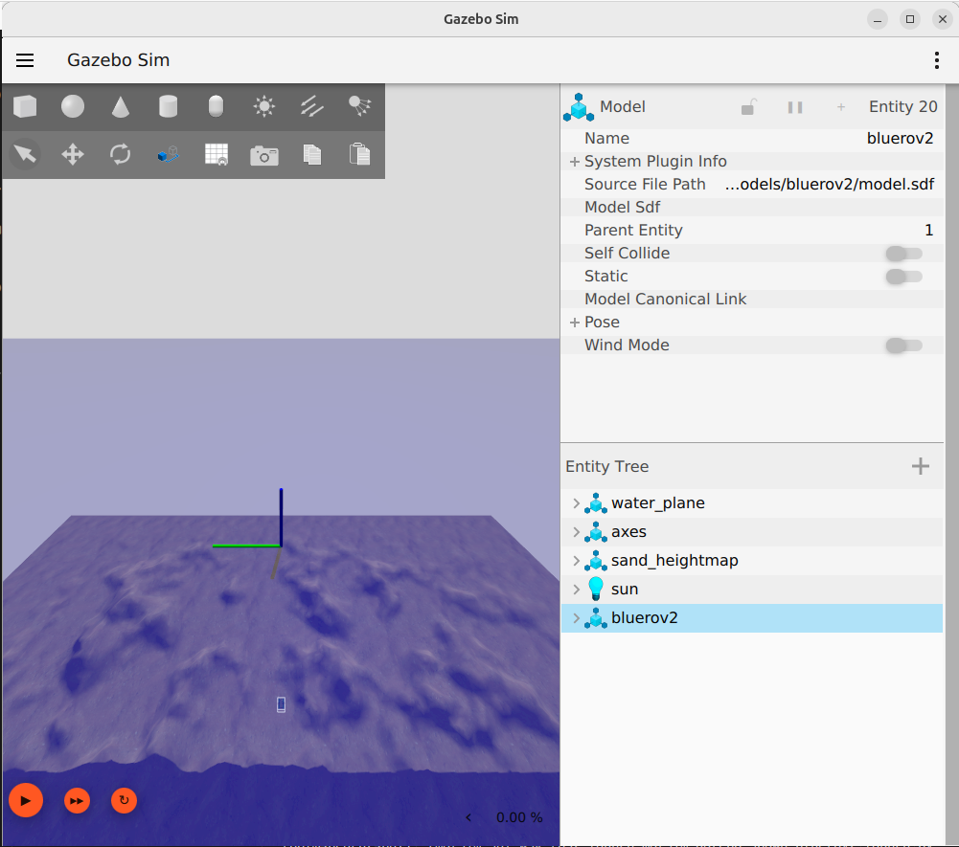
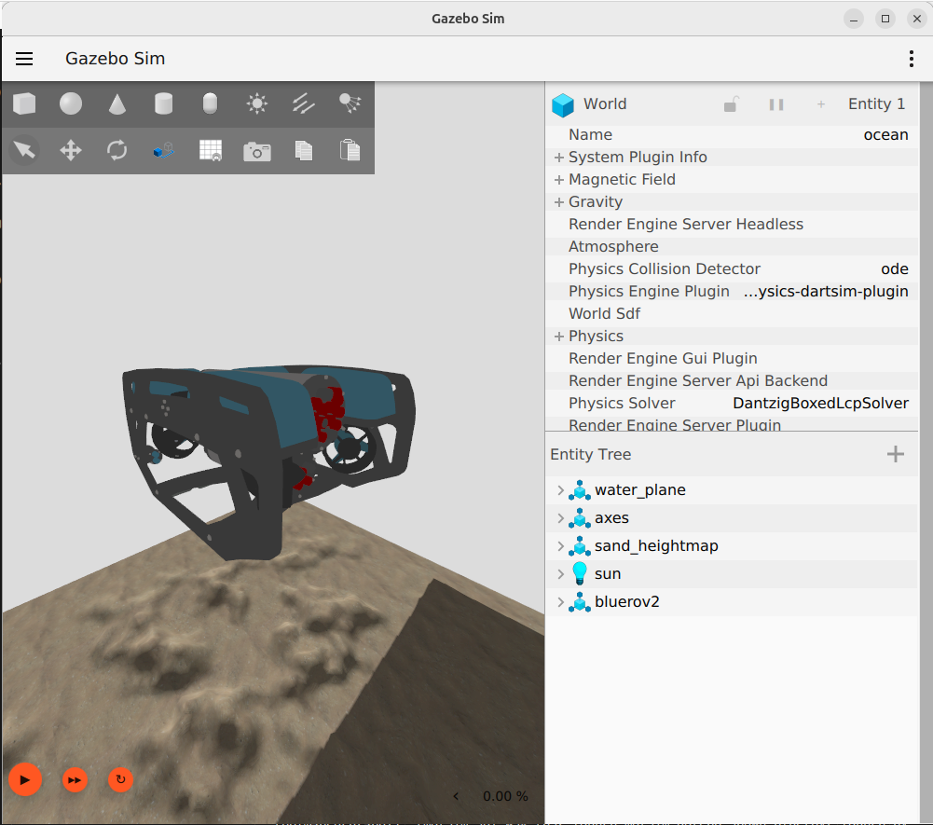
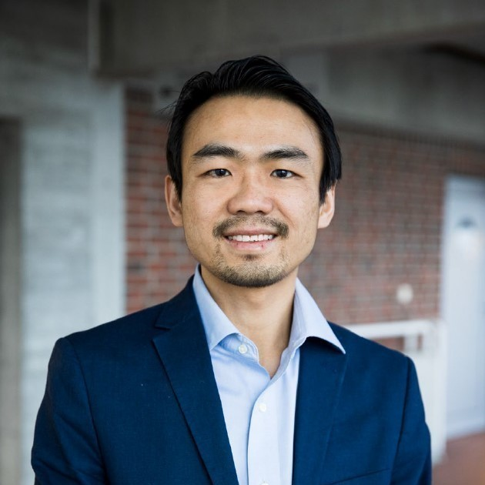
Welcome to Stavanger/Norway University of Stavanger uis.no
Bente Dale, International Office
An international university campus across 1300 acres of land
ROS2/Gazebo - Marine Simulator v1
Professor Yihan Xing
Study program leader, MSc Marine and Offshore

Slide 2
Agenda
Docker Engine
ROS2
Gazebo
BlueROV2 ROS2/Gazebo model

Slide 3
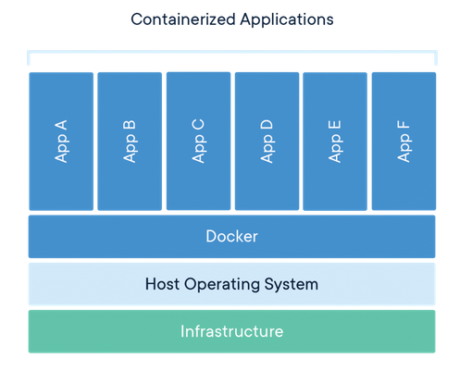
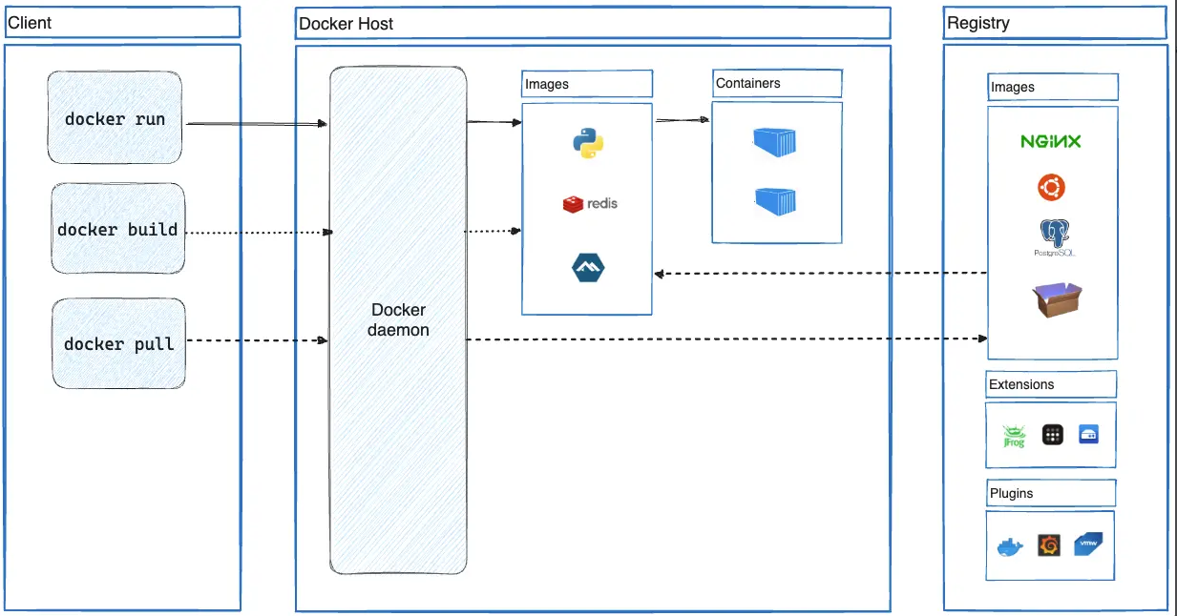
Docker Engine
Open-source containerization tool
Docker container:
Run-time environment with the applications to be run and their dependencies
Docker image:
Standalone and executable file that is used to create the container
Contains all files required (application, libraries, dependencies, etc.)
Sharable and portable
Source: https://www.docker.com/resources/what-container/
Source: https://docs.docker.com/guides/docker-overview/#docker-architecture

Slide 4
Docker workflow process
Step 1: Build the Docker image (Dockerfile)
Use a Dockerfile for easier defintion of the image to be built
Step 2: Load the Docker image as a container (load_dock.sh)
This is the main terminal of the container. Exiting from this terminal will unload the container.
No files will be saved in the container upon unloading.
Load and use a share volume from the host machine for saving work files.
Step 3: Access the running Docker container if more additional terminals are required (access_cont.sh)
Step 4: Exit from the container
Exiting from the main terminal will unload the container

Slide 5
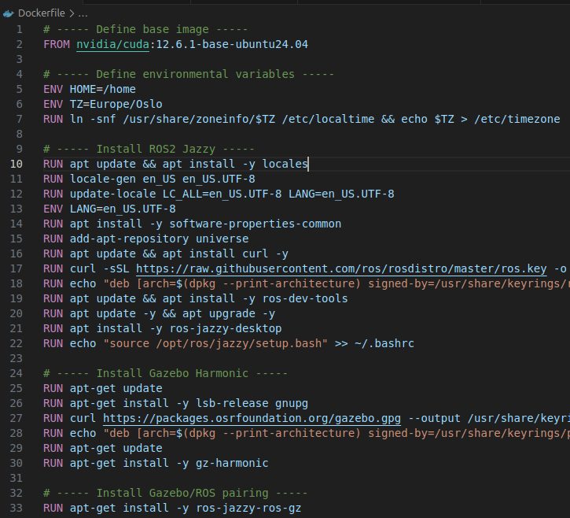
DockerFile
Base image
Example: nvidia/cuda:12.6.1-base-ubuntu24.04
https://hub.docker.com/r/nvidia/cuda
Reason: I am using a laptop that has NVIDIA RTX 2000 Ada. The Cuda base image has already many of the required graphics drivers pre-installed and configured.
Install packages
Sudo not required; the build process runs in root
Install ROS2 jazzy, Gazebo harmonic, Gazebo/ROS pairing, misc ROS2 tools and misc tools

Slide 6
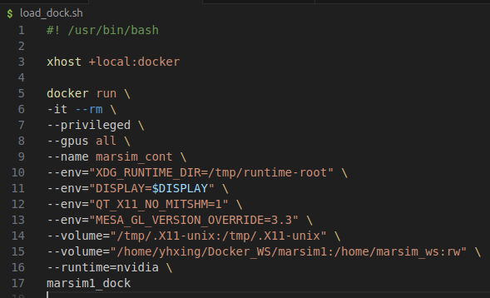
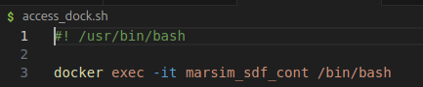
Load and run Docker container
load_dock.sh
load_dock.sh
xhost +local:docker: Allows the Docker container to access the host's X server for GUI applications.
Container options: -it: Interactive mode with a pseudo-TTY; --rm: Automatically remove the container when it exits; --privileged: Gives extended privileges to this container; --gpus all: Allows the container to use all available NVIDIA GPUs; --name marsim_sdf_cont: Names the container "marsim_sdf_cont".
Environment variables: XDG_RUNTIME_DIR=/tmp/runtime-root: Sets the runtime directory; DISPLAY=$DISPLAY: Passes the host's DISPLAY environment to the container; QT_X11_NO_MITSHM=1: Disables MIT-SHM extension for Qt applications: MESA_GL_VERSION_OVERRIDE=3.3: Forces OpenGL version 3.3 for Mesa drivers.
Volume mounts: /tmp/.X11-unix:/tmp/.X11-unix: Mounts X11 socket for GUI support; /home/yhxing/Docker_WS/marsim1:/home/marsim_ws:rw: Mounts a local directory into the container with read-write access;
--runtime=nvidia: Specifies to use the NVIDIA Container Runtime.
access_cont.sh
access_cont.sh

Slide 7
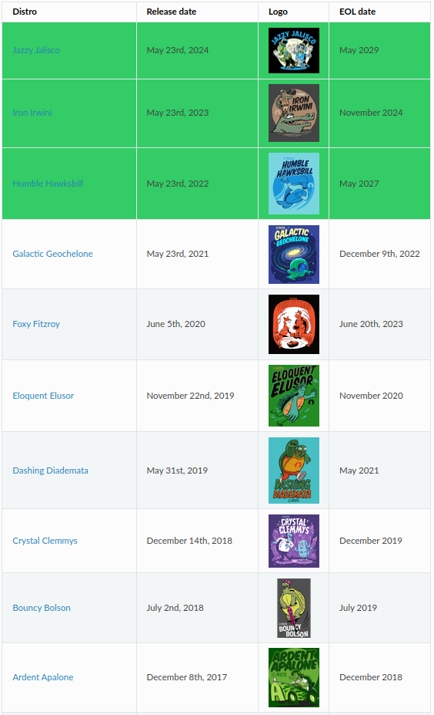
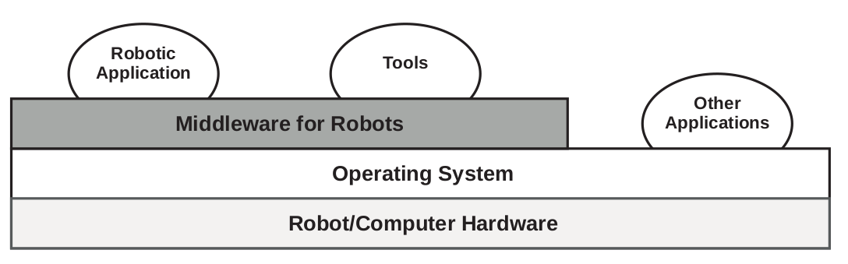
Robot Operating System 2 (ROS2)
Material is taken from Rico, F. M. (2022). A concise introduction to robot programming with ROS2. Chapman and Hall/CRC.
ROS2 is not an operating system; it is a middleware developed and maintained by the Open Robotics Foundation
Middleware is a layer of software between the operating system and the user applications
ROS2 is the 2nd generation of ROS
Source: Rico, F. M. (2022). A concise introduction to robot programming with ROS2. Chapman and Hall/CRC

Slide 8
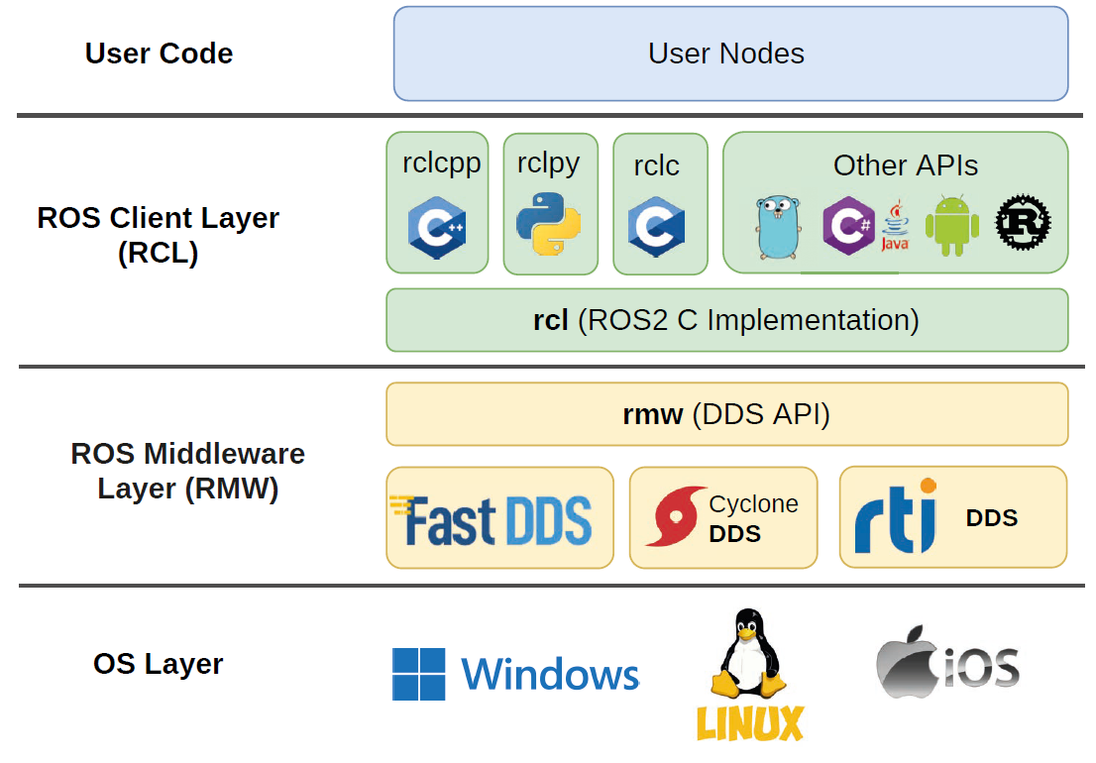
ROS2 architecture
User nodes interface with ROS2 via RCL’s APIs
rcl is the core of ROS2 and is written in C
rclcpp, rclpy, rclc, etc binds different programming languages to rcl offering the same behaviour, i.e., they are not independent implementations
ROS2 is a distributed system using data distribution system (DDS) as its communications layer
There are several DDS vendors; ROS2 Humble uses Cyclone DDS
Source: Rico, F. M. (2022). A concise introduction to robot programming with ROS2. Chapman and Hall/CRC

Slide 9
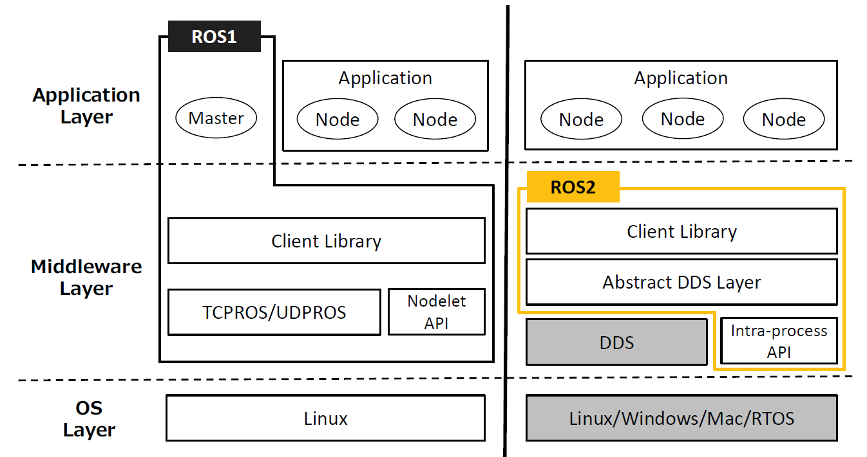
ROS2 vs ROS1
Architecture
DDS (ROS2) vs Master-Slave Architecture and the XML-RPC middleware (ROS1)
rcp with binders to any programming language (ROS2) vs two seperate libraries roscpp and rospy (ROS1)
Features
QoS, multi-threaded exectution and real-time processing
Tooling/Ecosystem
Not backward compatible, but interface with ROS1 can be done via ROSbridge
Maruyama, Y., Kato, S., & Azumi, T. (2016, October). Exploring the performance of ROS2. In Proceedings of the 13th international conference on embedded software (pp. 1-10).

Slide 10
Components of ROS2
ROS2 is open source
The community
Large community of users and developers contributing software packages
Computation graph
ROS2 runs as a computational graph consisting of nodes and arcs
Workspace
This is the user workspace that consists of the set of software installed on the robot or computer and the programs that the user develops

Slide 11
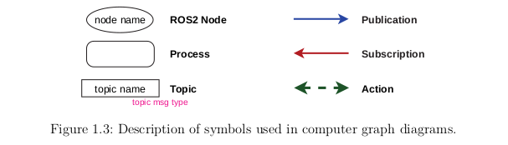
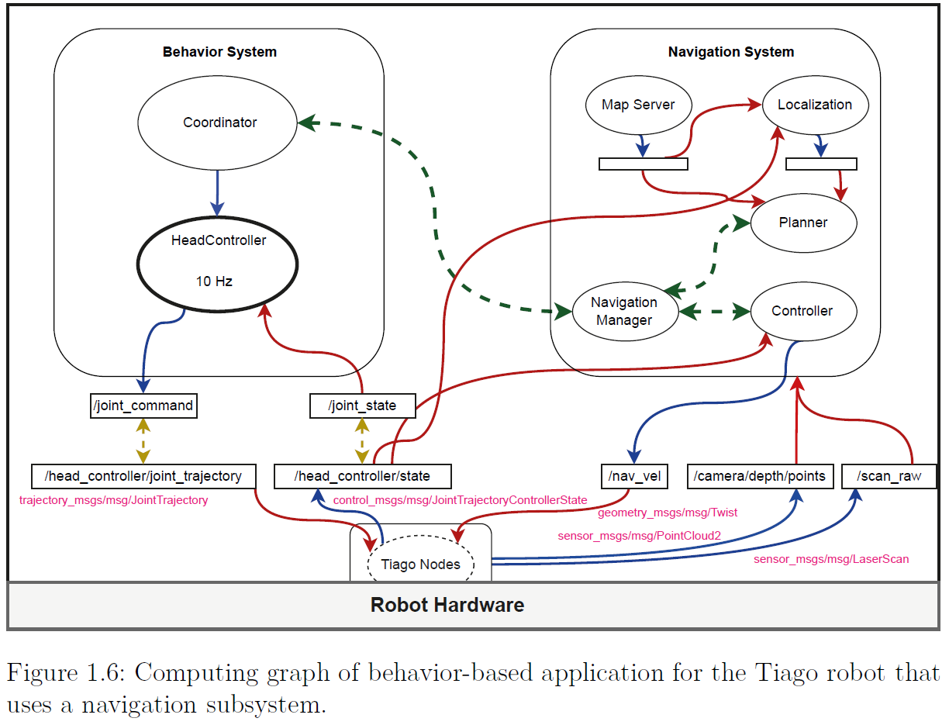
The computational graph
Node: single purpose executable program
Topic: a named bus over which nodes exchange messages
Publication/subscription: nodes sending/receiving messages on a topic
Service: a synchronous request/response interaction between nodes: must be completed before the next one begins
Action: an asynchronous request/response interaction with feedback; can be performed concurrently without waiting for each other to complete
Source: Rico, F. M. (2022). A concise introduction to robot programming with ROS2. Chapman and Hall/CRC

Slide 12
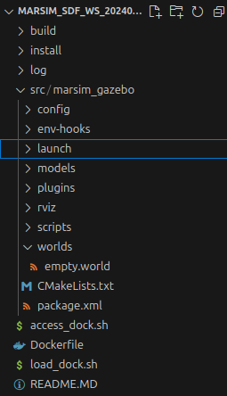
ROS2 workspace
Workspace directory
Source code of user programs (packages) are stored in src
The workspace can contain multiple packages
Each package is stored in 1 directory with CMakeList.txt and package.xml
Workspace needs to be built using colcon build
build, install and log directories are created
To run the packages, the workspace needs to be sourced after building
source install/setup.bash

Slide 13
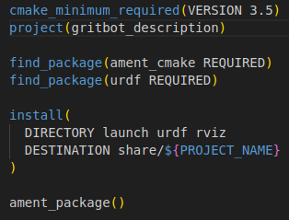
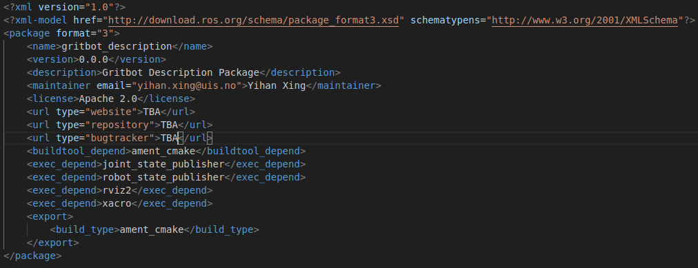
CMakeList.txt and package.xml
Must be placed at the root of the package directory
Defines the build tool, folders to be included, dependencies, etc

Slide 14
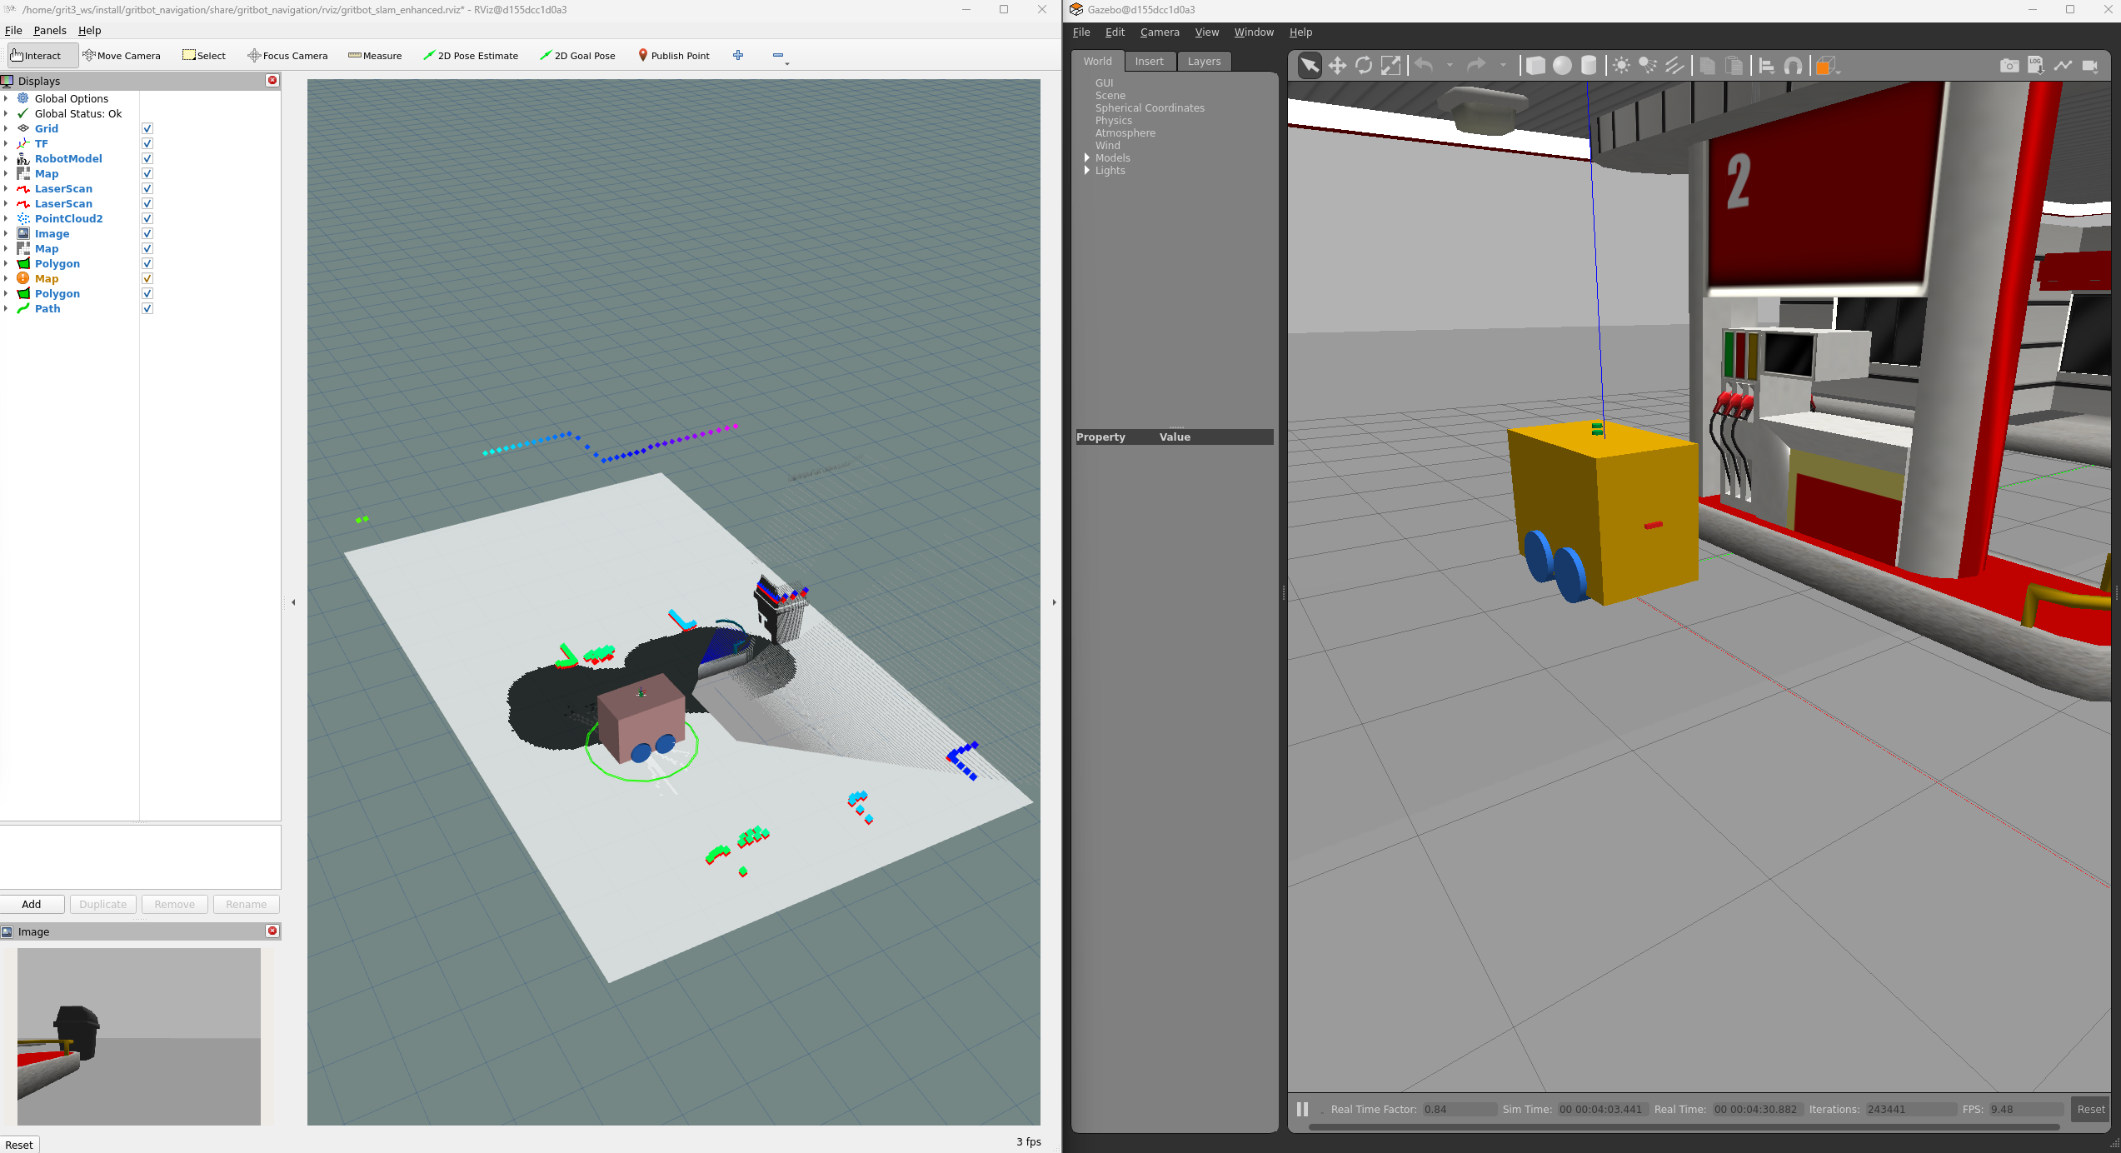
Rviz2
Port of Rviz to ROS2
Installed by ROS2 by default
Provides graphic interface for users to view the robot, sensor data, maps, etc

Slide 15
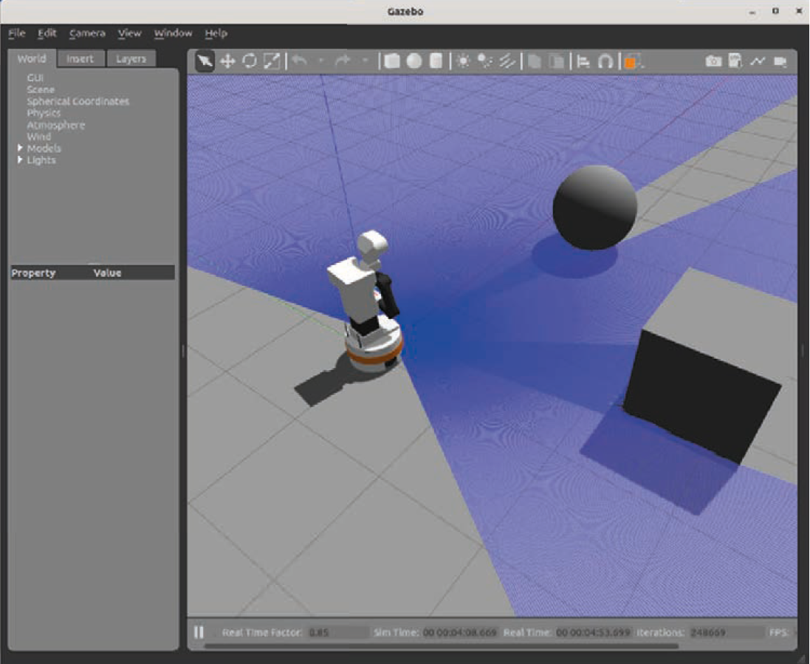
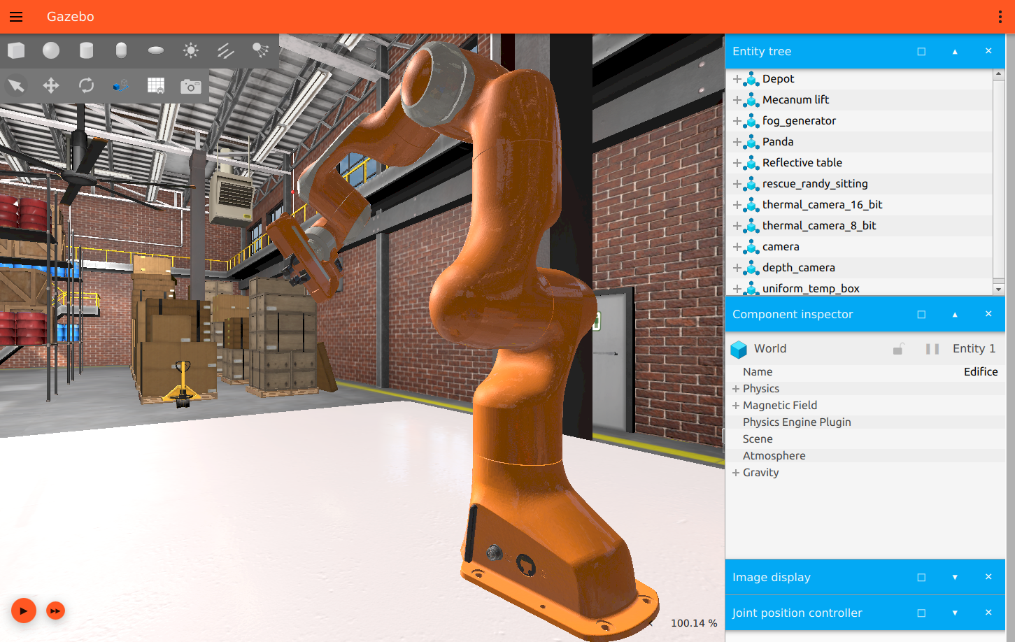
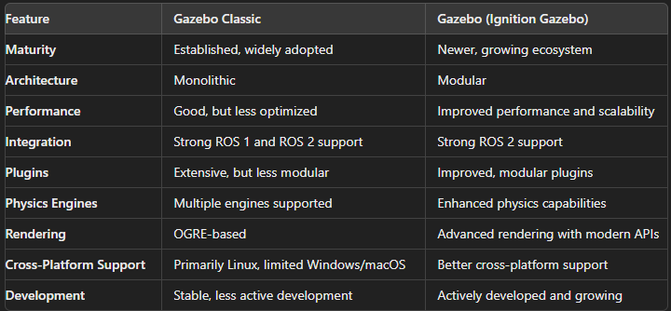
Gazebo
Open-source 3D robotics simulator developed and maintained by the Open Robotics Foundation
Commonly used together with ROS and ROS2
Features:
Physics engines: e.g., ODE, Bullet, Simbody and DART
3D graphics: uses Object-Oriented Graphics Rendering Engine
Sensors and actuators: e.g., lidar, IMU, cameras, GPS, etc
Plugins: easily extendable for custom functionalities
World and environment: allows for complex and dynamic environments
Multi-robot simulation
Gazebo classic and Gazebo (previously Ignition Gazebo)
We are using Gazebo Harmonic
Gazebo Classic. Source: Rico, F. M. (2022). A concise introduction to robot programming with ROS2. Chapman and Hall/CRC
Gazebo. Source: https://github.com/gazebosim

Slide 16
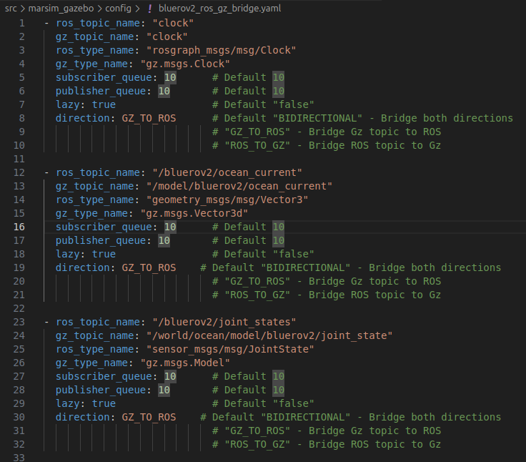
ros_gz_bridge
A network bridge which enables the exchange of messages between ROS 2 and Gazebo Transport
We need a bridge because the robot is simulated in Gazebo, while the robot is controlled in ROS2; the messages of the robot from Gazebo must be ported to ROS2
Limited to only certain message types
There are several ways to configure the bridge; we will use a yaml file, which is the easiest way

Slide 17
BlueROV2 ROS2/Gazebo model
World
Standard Gazebo physics, user commands, scene broadcaster, imu, sensors, dvl system and buoyancy plugins
Seabed modelling using a heightmap model
Custom-written Gauss Markov ocean current plugin
ROV main body with 6 thursters
Buoyancy modelled using a rectangular collision geometry
Standard Gazebo hydrodynamic, joint state publisher, pose publisher and odometry publisher plugins
Thruster attached to main body using revolute joints with standard Gazebo thruster plugins
Standard Gazebo IMU and DVL sensors with a custom-written ccp plugins and python scripts for post processing of measurements
Simulated depth sensor using standard Gazebo odometry publisher with added noise using a custom-written python script
ROS2 robot description and robot localization packages
Custom-written python script for robot keyboard controller

Slide 18
Custom-written plugins and scripts
Source codes are stored in /plugins and /scripts
marsim_gazebo::GaussMarkovOceanCurrent
marsim_gazebo::DVLRosConverter
depth_sensor_from_odom.py
noisy_odometry.py
ros_keyboard_controller.py
twist_stamper.py

Slide 19
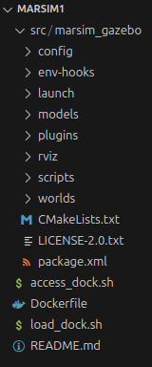
marsim1 ROS2/Gazebo model
Currently only the marsim_gazebo package
config: holds the configuration files such as the roz_gz_bridge yaml file
env-hooks: holds the files required to define paths
launch: holds the python launch files
models: holds folders which contain the models in sdf format
plugins: holds the cpp source codes (cc and hh files) for custom-made Gazebo plugins
rviz: holds the Rviz2 configuration yaml files
scripts: holds scripts that can be used to control the BlueROV2
worlds: holds sdf world files

Slide 20
Starting up the model
ros2 launch marsim_gazebo empty_world.launch.py
ros2 launch marsim_gazebo spawn_bluerov2.launch.py
ros2 launch marsim_gazebo start_bridge.launch.py
ros run marsim_gazebo ros_keyboard_controller bluerov2

Slide 21
ROS2-GZ bridge
We need a bridge because ROS2 and Gazebo are separate programs
Recap:
ROS2 (Robot Operating System 2):
A flexible framework for writing robot software
Provides a collection of tools, libraries, and conventions for robot development
Handles communication between different parts of a robotic system
Supports multiple programming languages (C++, Python, etc.)
Designed for distributed computing and real-time systems
Used for both simulated and physical robots
Gazebo:
A 3D dynamic simulator for robots
Provides accurate simulation of robots in complex indoor and outdoor environments
Offers realistic sensor feedback and physically plausible interactions
Can simulate multiple robots
Often used in conjunction with ROS/ROS2 for testing and development

Slide 22
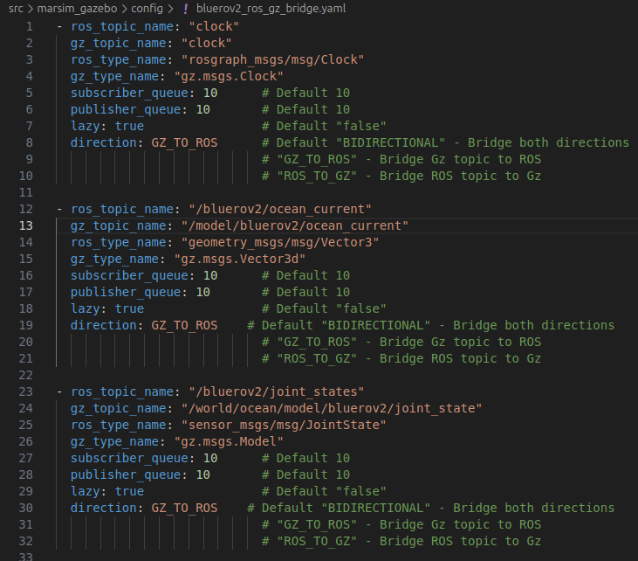
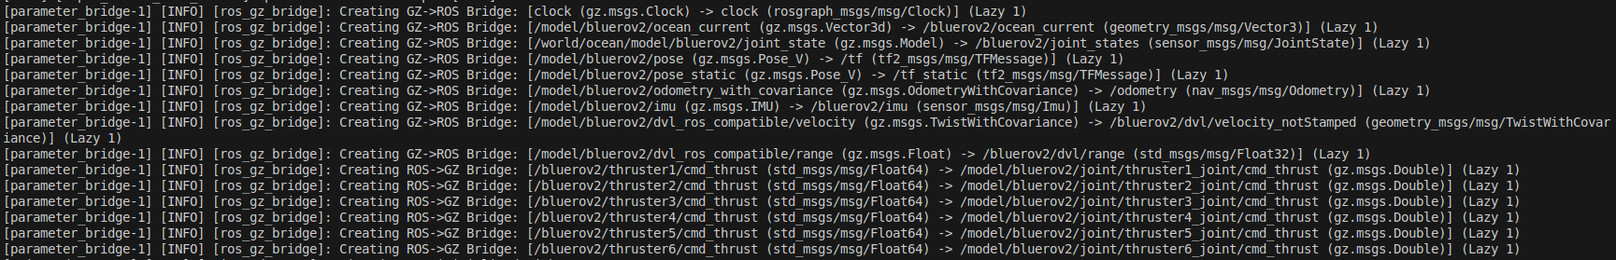
ROS2-GZ bridge
Configured using bluerov2_ros_gz_bridge.yaml
Gazebo is the simulator, and ROS2 is the robot computer
Environment and robot measurements: Gazebo ---> ROS2
Robot commands: ROS2 ---> Gazebo

Slide 23
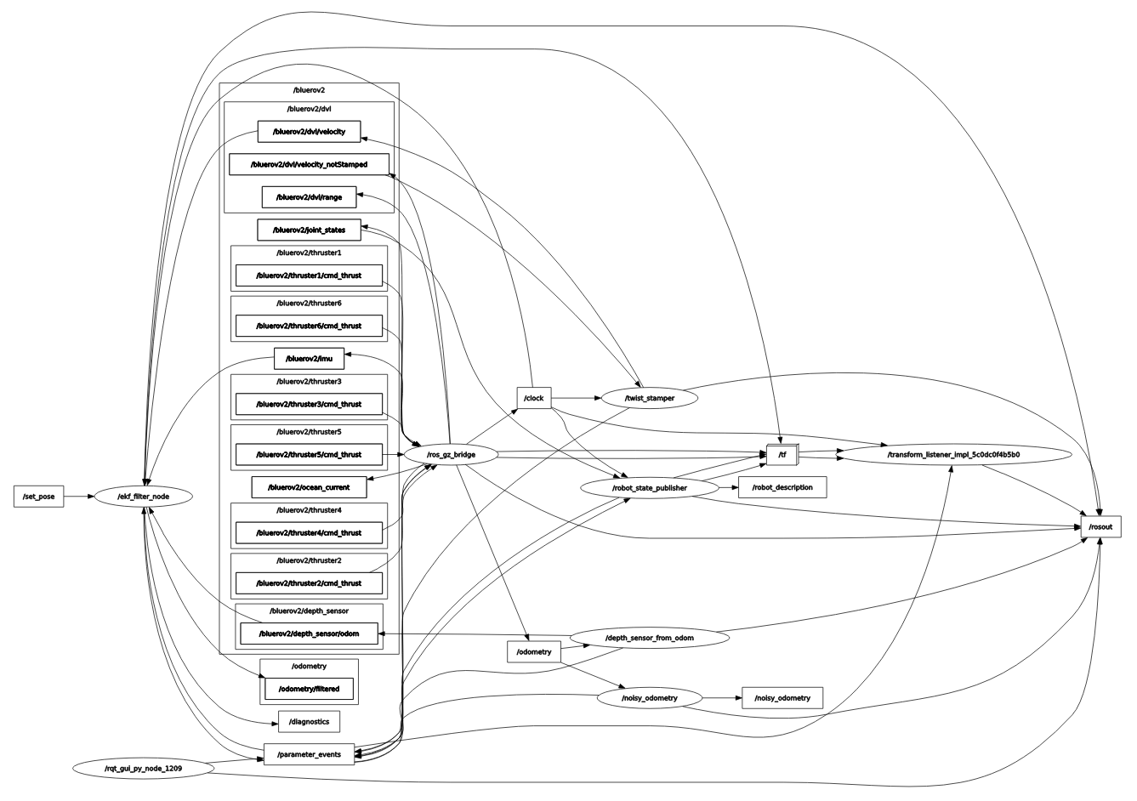
rqt_graph
Important nodes
/ros_gz_bridge
/ekf_filter
/robot_state_publisher
/depth_sensor_from_odom
/noisy_odometry
/twist_stamper
Important topics
/bluerov2
/tf
/robot_description
odometry
odometry/filtered

Slide 24
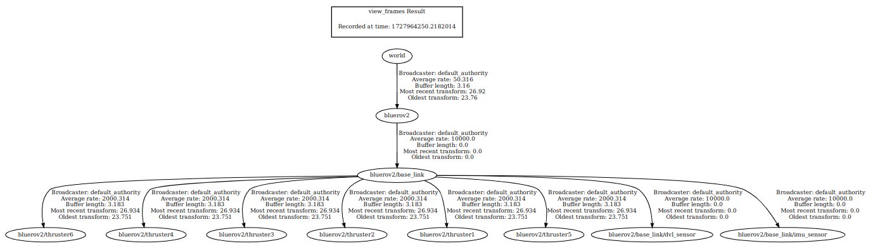
TF2 tree
No bluerov2/base_link/depth_sensor because the depth sensor is simulated using pose z measurements from /odometry with gaussian noise added

Slide 25
EKF filter
Implemented using ROS2 robot localization package
Configured using bluerov2_ekf_config.yaml
imu0: standard Gazebo IMU sensor
Orientations, angular velocities, linear accelerations
twist0
Linear velocities
odom0
Only pose z
Can be tuned through the defintion of the covariances

Slide 26
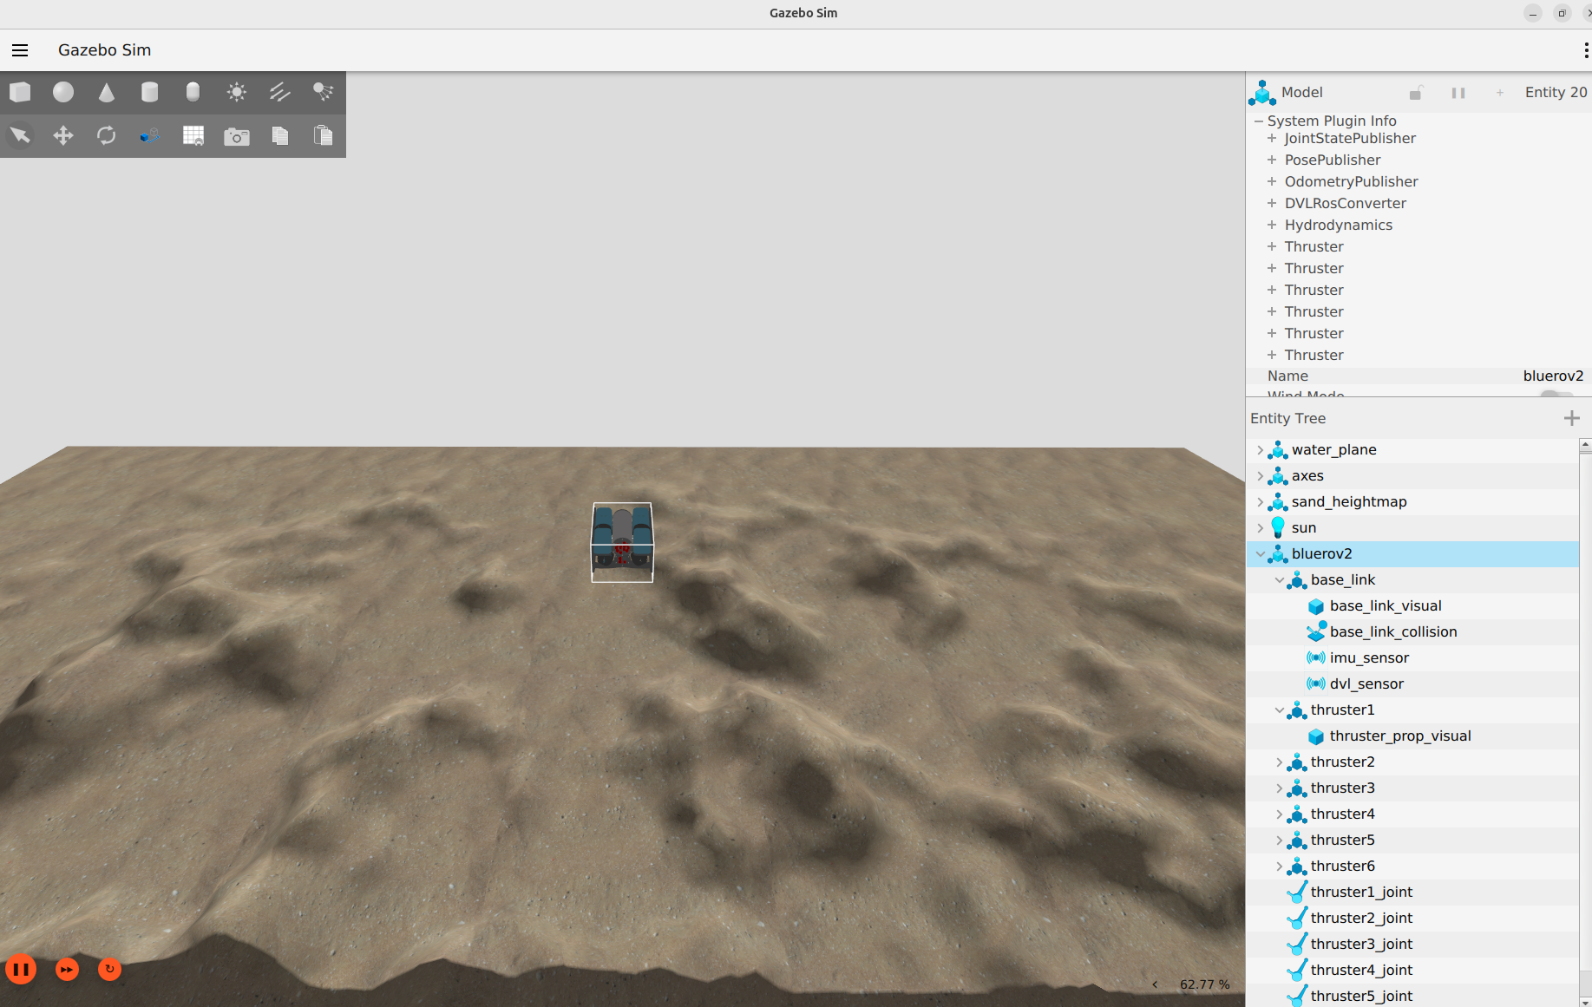

Slide 27
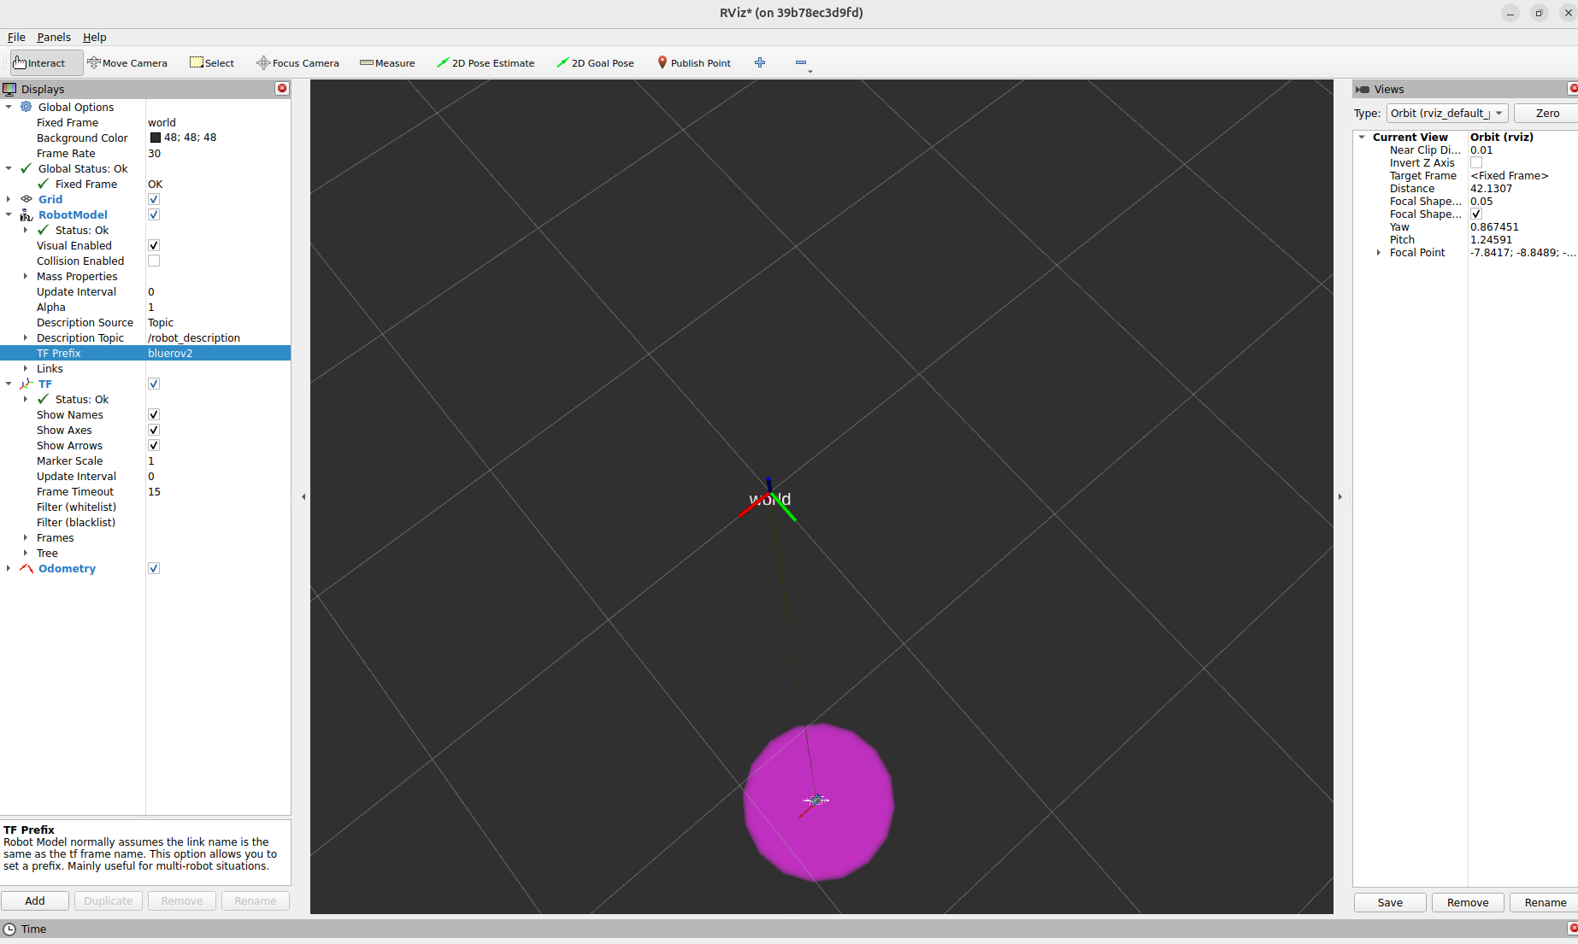

Slide 28
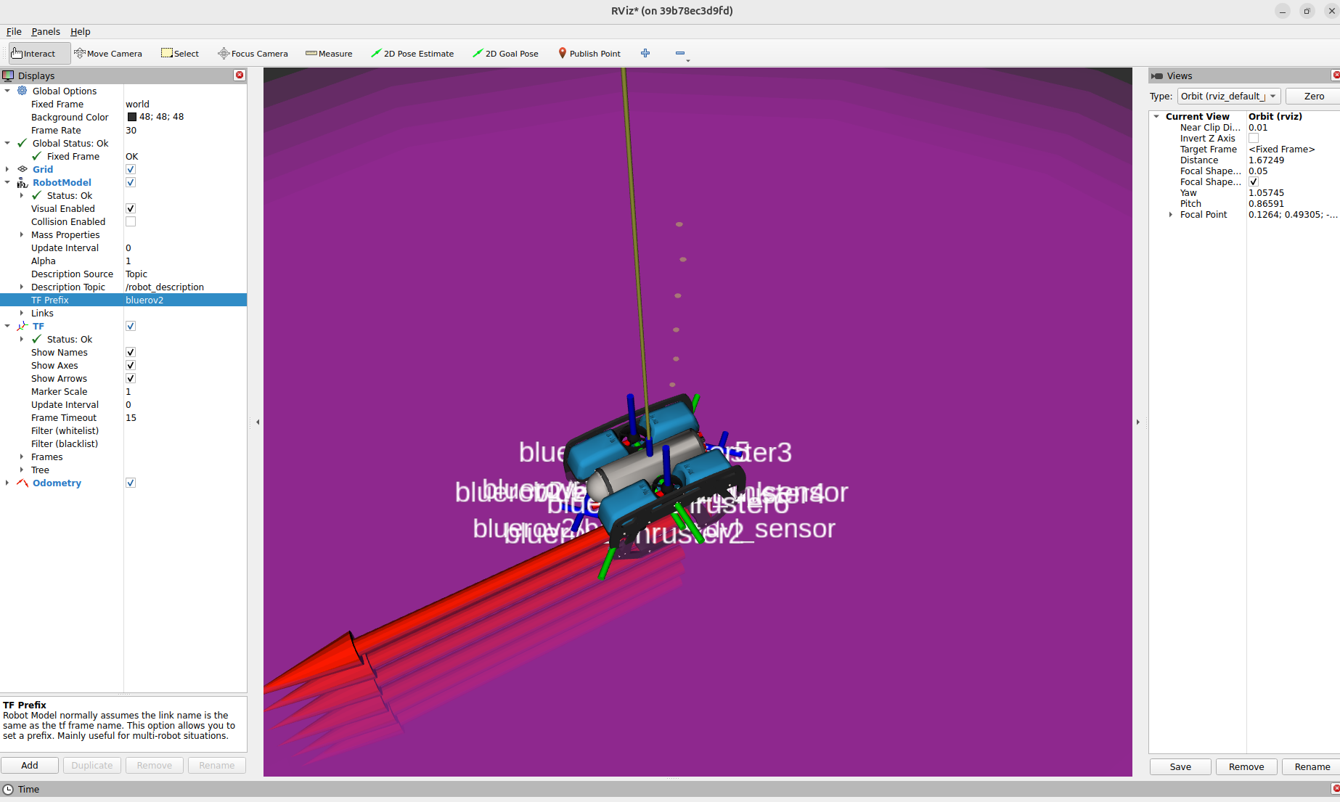

Slide 29
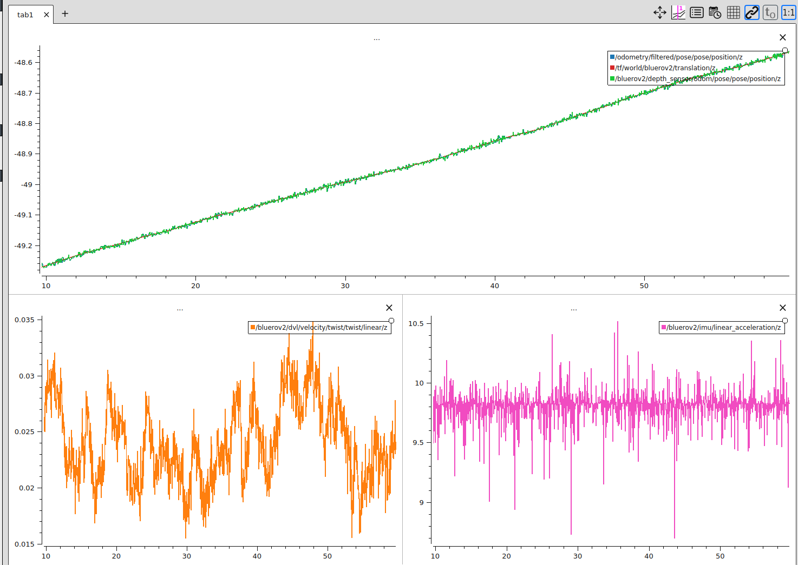

Slide 30
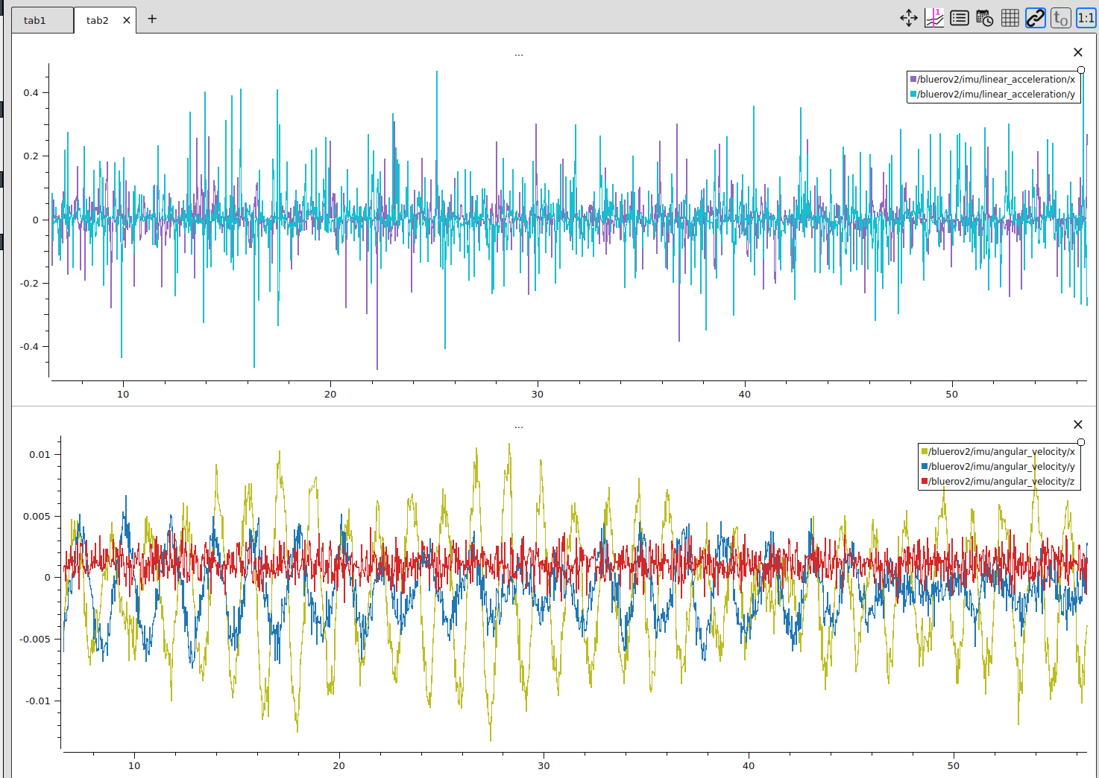

Slide 31
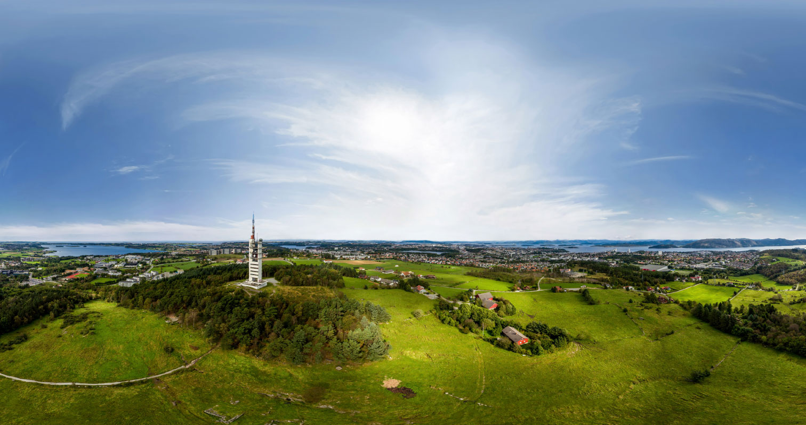
Thank you for your attention!

